Slide 1
IABP Intra‐aortic balloon pump counterpulsation

Slide 2
Acute circulatory support
Cardiogenic shock
Pharmacological support – undesirable side effects
Percutaneous mechanical support
Avoid undesirable effects
Maintain vital organ perfusion
Reduce intracardiac filling pressures, reducing congestion and/or pulmonary edema
Reduce left ventricular volumes, wall stress, and myocardial oxygen consumption
Augment coronary perfusion
Support the circulation during complex interventional and electrophysiologic procedures,
Notes:
Cardiogenic shock may be due to-Acute MI, Decompensated chronic heart failure, Acute MR, Acute AR, Acute myocarditis, VSR.
Pharmacological support which include inotropes, arterial and venous vasoconstrictor and vasodilators.
Undesirable side effects-tachycardia, arrhythmia, vasoconstriction with reduced tissue perfusion, increase myocardial oxygen demand.

Slide 3
Types of Percutaneous circulatory support devices
[Based upon different principles of operation and impact over ventricular hemodynamics]
IABP (aortic counter pulsation)
Impella (transvalvular ventricle to aortic pumping)
Tandem Heart (extracorporeal left atrial to arterial pumping
ECMO (extracorporeal venous to arterial bypass with membrane oxygenation

Slide 4
IABP
Historical Perspective
1958--Harken: Concept of diastolic augmentation and counterpulsation to treat LV failure
1962--Moulopoulus: From Cleveland clinic, developed an experimental (IAB) whose inflation and deflation were timed to cardiac cycle
1968--Kantrowitz: Introduce the (IAB) to the clinical practice in patient with post-infarction cardiogenic shock
Earlier IABP devices – Big, needed to be inserted via surgical method and manual
With advancement new devices – percutaneous, easy to operate and automated.

Slide 5
IABP: Physiology

Slide 6
IABP: Physiology
Systolic unloading
Diastolic augmentation
Cardiac cycle
1. Atrial systole (contraction)
2. Isovolumetric contraction
3. Ventricular systole/ejection
4. Isovolumetric relaxation (diastole)
5. Ventricular filling

Slide 7
Notes:
This is the figure showing pressure curve of aorta, left ventricle and left atrium during various cardiac cycle
In the top black line is aortic pressure curve
Explain dicrotic notch.
In the middle red line is left ventricle pressure curve
The action and effect of IABP takes place in ventricular diastolic phase. The pressure in aorta is raised during the diastole when aortic valve is closed which ultimately increases the blood flow to coronaries.

Slide 8
Notes:
Dicrotic notch represents aortic valve closure
Most of the blood flow into coronary circulation happens during diastole while the ventricle is relaxed
▪ Adequate diastolic pressure must be maintained to ensure perfusion of the coronary arteries and good myocardial oxygenation and or supply

Slide 9
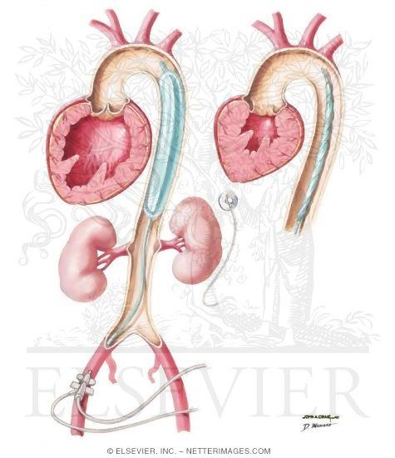
IABP: Physiology
How does IABP creates pressure effects?
By blood volume displacement (30 – 50 mL) in the aorta
By rapid shuttling of helium gas in and out of the balloon chamber placed in aorta
Resulting in changes in inflation and deflation hemodynamics
Appropriately timed according to cardiac cycle
Notes:
Appropriately timed so that we can get diastolic augmentation of pressure and systolic unloading.

Slide 10
IABP: Physiology
INFLATION
Principle of inflation counterpulsation
Balloon should be inflated at the start of diastole
Just prior to the Dicrotic Notch
Aortic volume and pressure are increased through displacement principles
Goal - To increase or augment perfusion
Notes:
The principles of counterpulsation state that the balloon should be inflated at the start of diastole, just prior to the Dicrotic Notch. Aortic volume and pressure are increased through displacement principles causing:
Increased coronary perfusion pressure
Increased systemic perfusion pressure
Increased O2 supply to both the coronary and peripheral tissue
Increased baroreceptor response
Decreased sympathetic stimulation causing decreased Heart Rate, decreased Systemic Vascular Resistance, and increased Left Ventricular function

Slide 11
IABP: Physiology
INFLATION
Hemodynamic Effects-
Increased coronary perfusion pressure
Increased systemic perfusion pressure
Increased baroreceptor response
Decreased sympathetic stimulation causing decreased HR, decreased SVR, and increased LV function
Increased coronary artery blood flow
Increased renal, cerebral and other distal organs blood flow

Slide 12
IABP: Physiology
DEFLATION
Principles of counterpulsation
Deflation at the start of systole, during Isovolumetric Contraction.
Deflation creates a "potential space" in the aorta, reducing aortic volume and pressure
Goal - To reduce LV workload
Hemodynamic Effects
Reduction in peak systolic pressure, therefore a reduction in LV work
Increased cardiac output
Improved ejection fraction and forward flow
Notes:
Reduced afterload allows the LV to empty more effectively so stroke volume (SV) is increased
Enhanced forward cardiac output decreases the amount of blood shunted from left to right in cases of intraventricular septal defects and incompetent mitral valve

Slide 13
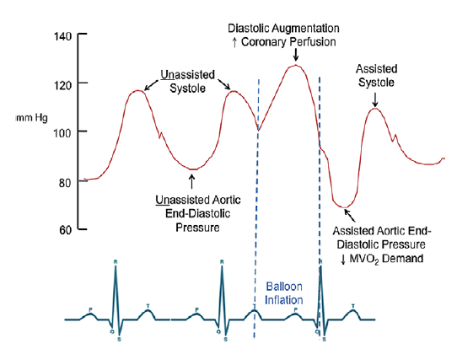

Slide 14
IABP: Physiology
The IABP has the following primary effects:
Increases coronary artery perfusion
Only in normal coronary arteries
No augmentation beyond severe stenoses pre PCI
Augmentation beyond severe stenoses post PCI
Increases myocardial oxygen supply
Decreases myocardial oxygen demand
Decreases myocardial work by reducing afterload
Increases blood pressure
Notes:
So overall due to inflation and deflation of the IABP during systole and diastole following physiological effects are seen.

Slide 15
IABP: Physiology
IABP - secondary effects
Decreases pulmonary artery pressure
Decreases SVR
Increases cardiac output and cardiac index
IABP - systemic effects
Increased cerebral perfusion
Increased renal perfusion

Slide 16
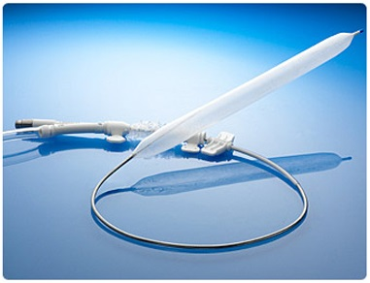
IABP - Components
IABP Catheters
Cylindrical polyurethane balloon
Length 20-30 cm
Volume 30-50 ml
Mounted over flexible shaft
Double lumen catheters
To shuttle gas in and out from balloon
To deliver catheter over the guidewire and subsequent monitoring of central aortic pressure
Early balloon console used CO₂ but now helium gas is used

Slide 17
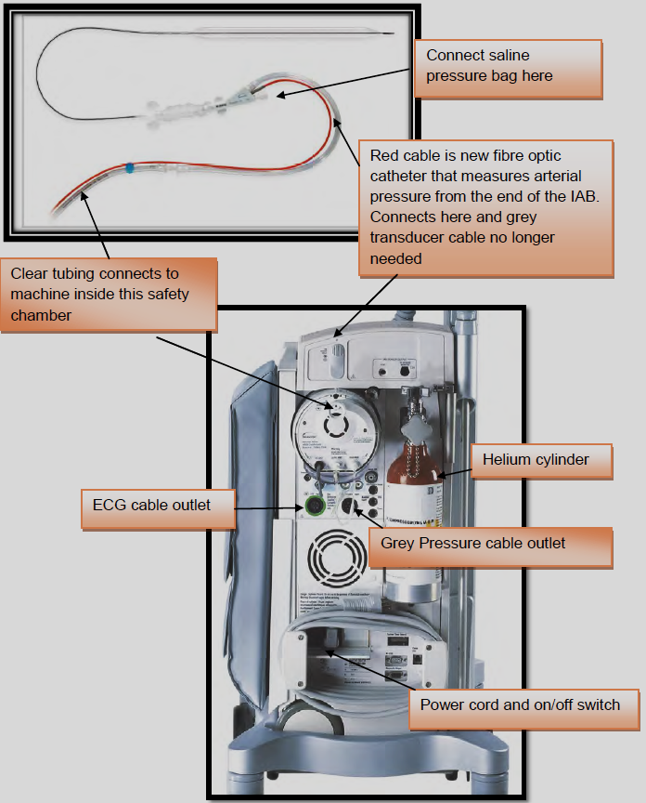

Slide 18
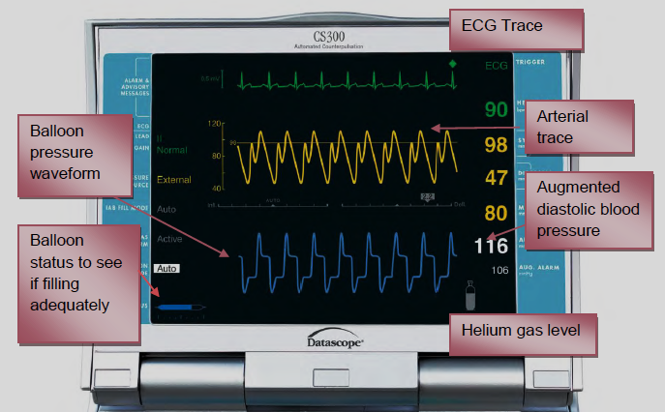

Slide 19
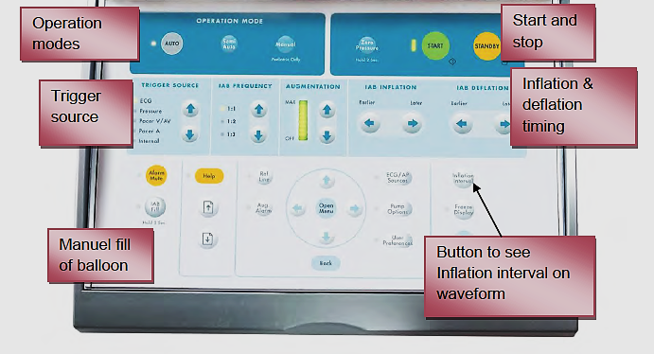

Slide 20
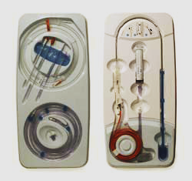
IABP INSERTION
IABP Kit
Introducer needle
Guide wire
Vessel dilators
Sheath
IABP (34 or 40cc)
Gas tubing
60-mL syringe
Three-way stopcock
Arterial pressure tubing (not in kit)

Slide 21
IABP INSERTION
IABP catheter size
Determined by the patient’s height.
The sizes are displayed on the IAB catheter box
Paediatric balloons also available in 2.5,5.0, 12.0 and 20 ml
Volume | Length | Diameter | HEIGHT
25 cc | 180 mm | 13 mm | < 152cm ( <5f)
34 cc | 230 mm | 13.9 mm | 152-162cms ( 5f- 5f 4 inches)
40 cc | 260 mm | 15 mm | 162-183cms (5f 4inches – 6f )
50cc | 270 mm | 18 mm | > 183cms ( > 6f )

Slide 22
IABP INSERTION
Surgical cut down method
Percutaneous insertion with sheaths
Sheath less insertion
Notes:
Surgical cut down method were used earlier when catheter were used to be large. Now since all catheters are of smaller size (7-8 F)percutaneous insertion are now usually done.

Slide 23
INSERTION OF IABP
Percutaneous insertion
Preprocedure evaluation
Choose groin with strongest femoral pulse
Consider iliac angiogram
Documentation of pedal pulses before IABP inserted
7F or 8F sheath is inserted
Regular guidewire exchanged with thin guidewire supplied in IAB kit
Prior to insertion-evacuate air from balloon and flush guidewire lumen with heparin-saline
Notes:
Pre procedure clotting parameters including BT, CT, PTINR, APTT, platelets count

Slide 24
Advance IABP over wire under fluoro
Distal (cephalad) marker placed near carina, 2 cm distal to the origin of left SCA
Guidewire removed and blood is aspirated to ensure no air is trapped.
Connection with pressure tubing and gas line
If long sheath is used partial withdraw before starting counterpulsation.
Counterpulsation started at half volume with 1:2 or 1:3 setting and then time setting adjustment is done
After adjustment full volume counterpulsation started.
Confirm uniform cylindrical shape of balloon under fluoro and no kinking.

Slide 25
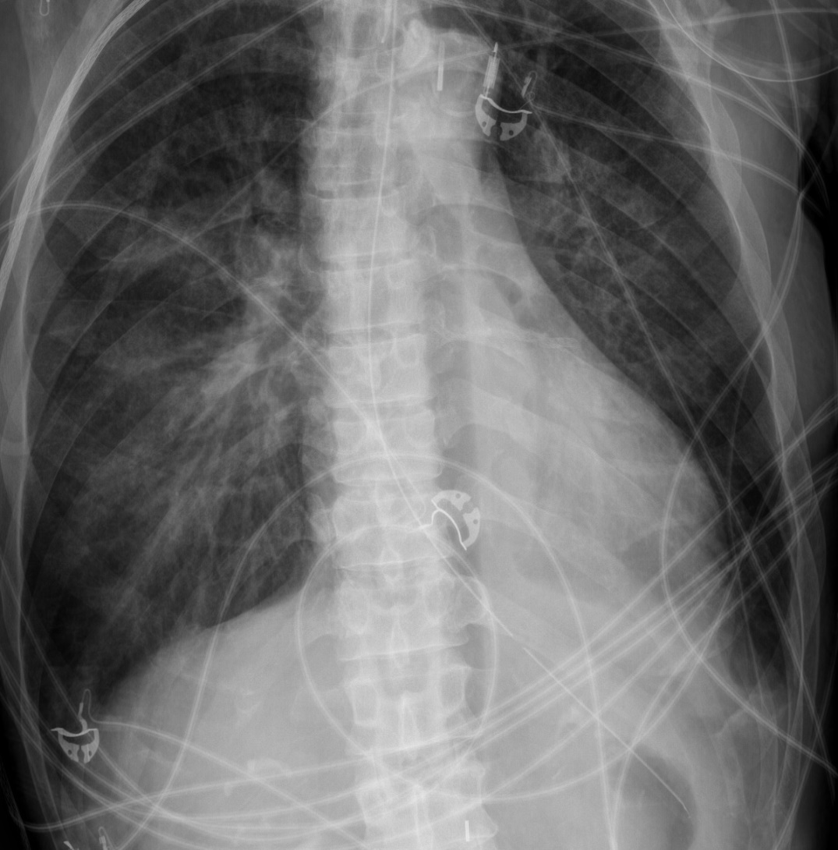

Slide 26
INSERTION OF IABP
Sheathless Insertion
Tapered nose
Directly inserted over guidewire
Predilate the soft tissue
Undue pressure and kinking avoided
If difficult to insert then reverted to sheathed insertion.
Notes:
Benefit and drawback.

Slide 27
IABP Trigger
Reliable trigger signal necessary before balloon pumping can begin
Trigger signal provides stimulus to the console to cycle the pneumatic system, which inflates and deflates the balloon
If the trigger is lost after pumping starts, no further pumping will occur until a trigger is re-established
If the current trigger is lost the machine automaticlly choose an alternate, available trigger to resume pumping
ECG Triggered
Arterial pressure waveform Triggered
Notes:
The console MUST see a trigger to initiate an inflate/deflate cycle.
If no trigger signal is sensed machine will not start pumping.
Also If the trigger is lost after pumping starts, no further pumping will occur until a trigger is re-established
Automatic or operator can switch between different modes.

Slide 28
ECG Trigger
IABP Trigger
In most instances -- trigger of choice.
R wave of the ECG - preferable as the trigger signal
R wave – ventricular systole – IABP deflation – IABP inflation
The computer analyzes the SLOPE and HEIGHT of a positively or negatively deflected QRS complex.
Very important to give the IABP a good quality ECG signal and lead
Other trigger options - when the R wave cannot be used or is not appropriate
Notes:
Since triggering on the R wave of the ECG is preferred, it is very important to give the IABP a good quality ECG signal and lead
Rejects pacer spikes on the basis of sharp rising edge.
Automatically initiates ARRHYTHMIA TIMING when at least 8 out of 16 beats are detected as irregular.

Slide 29
ECG Trigger
IABP Trigger
Note: changing QRS morphology may cause wandering timing
Note: tall T waves may cause double triggering or may alter previously set timing points
Note: wandering baseline may cause skipped trigger
Note: artifact may cause inappropriate triggering
Notes:
In AUTOPILOT mode, if no QRS or AP trigger is found, it will trigger on the V SPIKE of an AV paced rhythm.
In OPERATOR mode, the ECG trigger key can be used to toggle between triggering on the R WAVE and the V SPIKE of a V or AV paced rhythm.

Slide 30
AP Trigger
IABP Trigger
Arterial pressure provides another signal to the IABP to determine where the cardiac cycle begins and ends
Trigger signal -- SYSTOLIC UPSTROKE of an arterial pressure waveform.
A 14mmHg minimum pulse pressure is required to initially recognize the trigger.
Once pumping begins the subsequent pulse pressure requirement is reduced to 7mmHg.
Every 64th beat is unassisted and reassessed.
This mode is available as an option for clinical situations where an ECG is unavailable or distorted.

Slide 31
IABP Counterpulsation Timing
Accurate timing -- must to give full benefit of augmentation to the patient
Incorrect timing – increase workload to heart
Timed by comparing the arterial pressure waveform while the balloon is augmented with the cardiac cycle
A good arterial trace is essential for proper timing to occur
Timing should be checked on a 1:2 or 1:3 ratio.
Notes:
Timing should be checked on a 1:2 or 1:3 ratio so you can see a normal beat and press the inflation interval key.

Slide 32
IABP Counterpulsation Timing
Inflation:
During diastole when the aortic valve closes and the left ventricle relaxes
Blood is not being pumped forward by the heart, therefore with the balloon inflated at this time the flow of blood will not be impeded
Aortic valve closure is represented on the arterial trace by the dicrotic notch
Inflation of the balloon is timed to occur at the dicrotic notch on the arterial pressure trace

Slide 33
IABP Counterpulsation Timing
Deflation:
Deflation is timed to occur just before the next systole
It is the depression of the balloon and the transfer back of helium into the console
Can be seen on the IABP monitor as half way down the down slope after the dicrotic notch, prior to the aortic valve opening

Slide 34
IABP Counterpulsation Timing

Slide 35
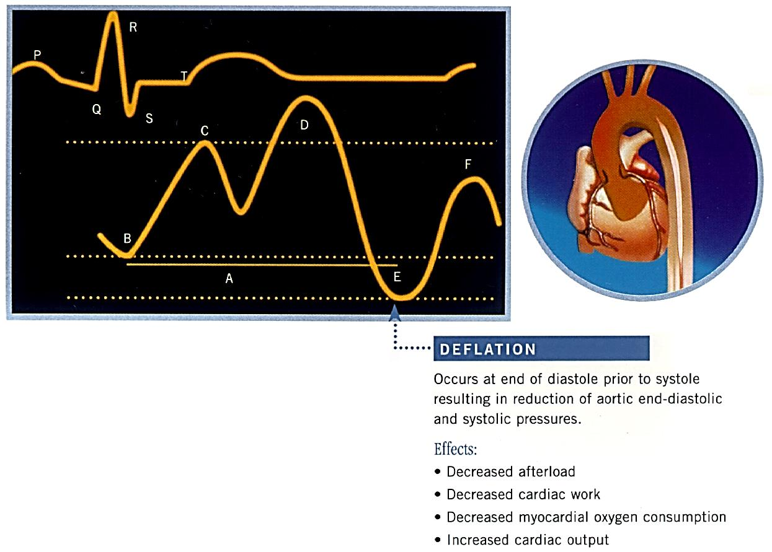
IABP Counterpulsation Timing

Slide 36
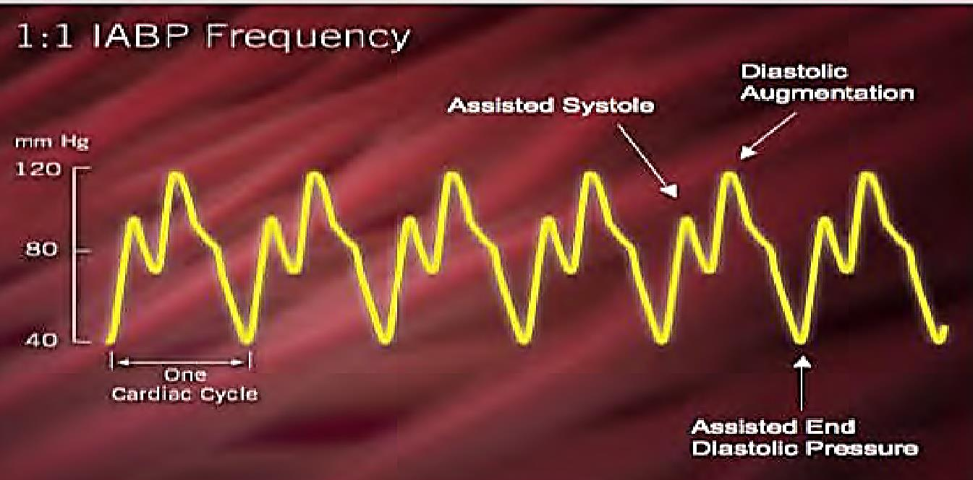
IABP Counterpulsation Timing
1:1 frequency: balloon inflates every beat
Provides maximum augmentation

Slide 37
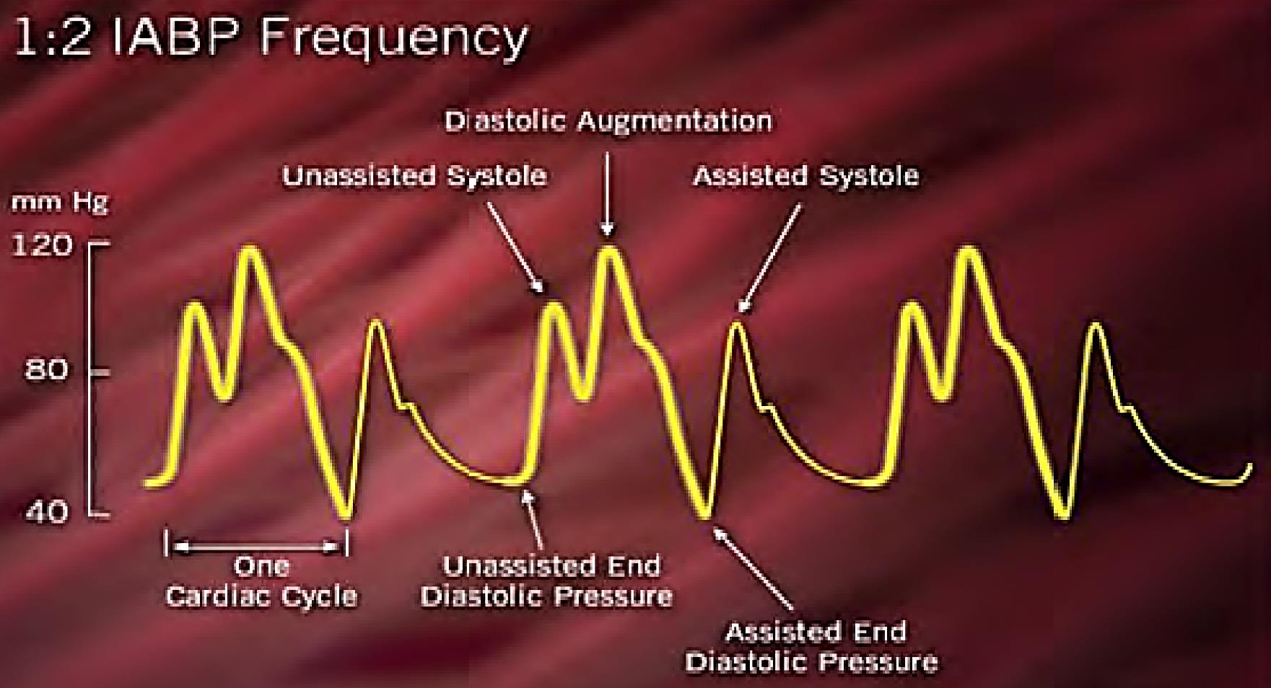
IABP Counterpulsation Timing
1:2 frequency: balloon inflates/augments every 2nd beat
Utilised for weaning and checking timing

Slide 38
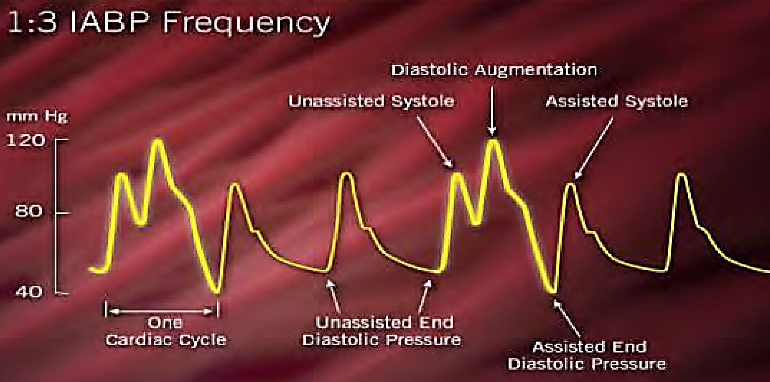
IABP Counterpulsation Timing
1:3 frequency: balloon inflates / augments every third beat
Utilised for weaning

Slide 39
Timing : Troubleshooting

Slide 40
Timing : Troubleshooting

Slide 41
Timing : Troubleshooting

Slide 42
Timing : Troubleshooting

Slide 43
Timing : Troubleshooting

Slide 44
Timing : Troubleshooting

Slide 45
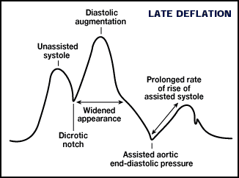
Timing : Troubleshooting
Waveform Characteristics:
Assisted aortic end-diastolic pressure may be equal to the unassisted aortic end diastolic pressure.
Rate of rise of assisted systole is prolonged.
Diastolic augmentation may appear widened.
Physiologic Effects:
Afterload reduction is essentially absent.
Increased MVO2 consumption due to the left ventricle ejecting against a greater resistance and a prolonged isovolumetric contraction phase.

Slide 46
IABP : Balloon Pressure Waveform
Displayed as the bottom waveform on the console.
Two important points about the shape of the waveform are:
Width of the waveform corresponds to the duration of balloon inflation during the cardiac cycle
Plateau of the waveform reflects pressure within the aorta when the balloon is inflated.
Plateau pressure on the BPW should be within ± 20 mmHg of the diastolic on the arterial pressure waveform
Notes:
The balloon pump has to overcome the pressure within the aorta to fill the balloon with gas. Since the balloon material is very compliant, the pressure on either side will be approximately the same

Slide 47
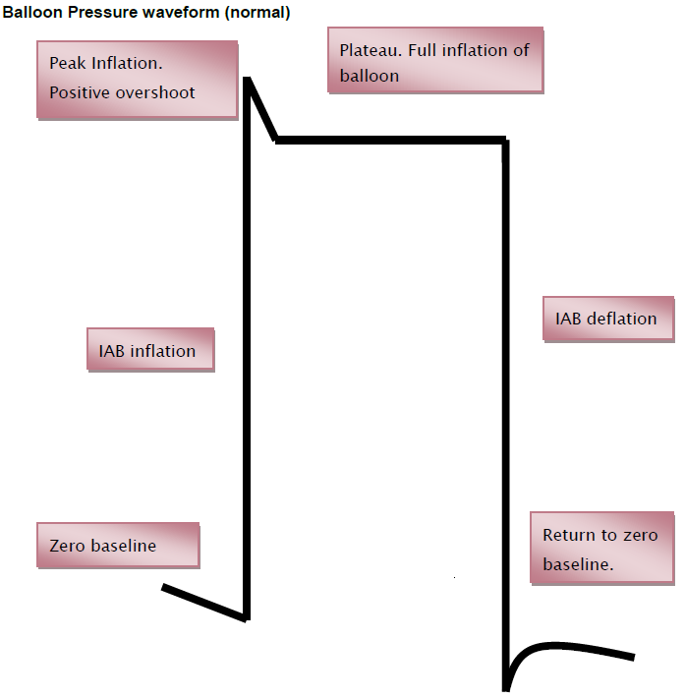

Slide 48
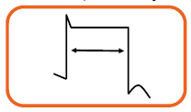
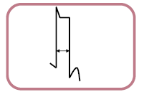
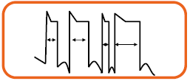
IABP : Balloon Pressure Waveform
Bradycardia: increased duration of plateau due to a longer diastolic phase
Tachycardia: decreased duration of plateau due to shorter diastolic phase
If the heart rate is erratic, as in atrial fibrillation or there are frequent premature complexes, the waveform will have varying widths
Notes:
Variations in balloon pressure waveforms
Changes in balloon pressure waveforms maybe due to the following:

Slide 49
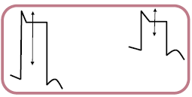
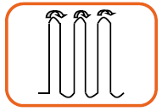
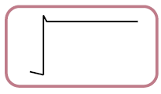
IABP : Balloon Pressure Waveform
Blood pressure: affects the amplitude of the waveform
Catheter Kink: Rounded balloon pressure waveform, loss of plateau
This may be due to
kink or obstruction of shuttle gas
kink in the catheter tubing
improper IAB catheter position
sheath not being pulled back to allow inflation of the IAB
IAB is too large for the aorta
Sustained inflation: Theoretical possibility if the IAB remains inflated longer than 2 seconds. System Failure alarm is activated which deflate IAB.

Slide 50
IABP and CPR
Effective CPR generating sufficient blood pressure
Arterial pressure trigger mode
If CPR not effective and not generating a consistent and reliable trigger
INTERNAL TRIGGER mode.
INTERNAL TRIGGER -- asynchronies counter pulsation -- should never be used if patient’s ECG or arterial pressure source available.
To maintain movement of the catheter at fixed interval -- reduce the risk of thrombus formation.
Notes:
Interval trigger mode is one of the last option in the trigger panel of console.
To select INTERNAL, the INTERNAL TRIGGER key must be depressed TWICE.

Slide 51
IABP and CPR
Decrease the assist interval
Decrease the volume of the IAB.
Manual mode
No C/I for defibrillation as IABP has protection and isolation
Once the ECG or arterial signal has been re-established – switch back from INTERNAL to an acceptable patient trigger.

Slide 52
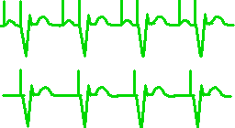
IABP and pacemaker & Arrhythmias
Trigger – ECG – R wave
The computer analyzes the SLOPE and HEIGHT of a positively or negatively deflected QRS complex.
Rejects pacer spikes on the basis of sharp rising edge.
ARRHYTHMIA TIMING when at least 8 out of 16 beats are detected as irregular.
AUTOPILOT mode -- V SPIKE of paced rhythm.
OPERATOR mode -- manual toggle between triggering on the R WAVE and the V SPIKE of paced rhythm.
For irregular rhythm deflation timing is adjusted to occur at the peak of R wave
Notes:
Arrhythmia timing automatically activate autopilot mode.
Autopilot mode first search R wave, then AP, and if both not found, V spike
For arrhythmia aim is to avoid ventricular ejection against inflated balloon which may occur if R-R interval is short.

Slide 53
IABP : Management during counterpulsation
Patient Management
Should be done in ICU setting
Full physical assessment with special attention to peripheral perfusion, colour, bilateral pulses, temperature, capillary return, movement and sensation
Patient education
Pressure area care 2 – 4hourly as patient immobile
Hourly haemodynamic observations recorded
Patient nursed supine 30-45 degrees head up. May be nursed on side as long as leg with IABP is kept straight
Check IAB site regularly for signs of infection and change occlusive clear dressing
Notes:
Patient education about IABP and specially on not to bend leg with IAB

Slide 54
IABP : Management during counterpulsation
Anticoagulation
Heparin 5000 units before insertion
Followed by continuous infusion
APTT 1.5 to 2 times normal
Selective use of heparin
No recommendations by manufacturers
Generally not thought to be necessary if pumping 1:1
Reasonable if during a long wean while pumping 1:2 or 1:3
Notes:
Recent study have shown that selective use of heparin (using heparin only for a clinical condition other than IABP) is associated with lower bleeding risk without an increase in ischemic complication when compared to routine use.

Slide 55
IABP : Management during counterpulsation
Pathology & Tests:
Daily CXR to ensure correct placement of IABP and ensure that it has not migrated.
Daily pathology for electrolytes, coagulation, sepsis, hemolysis and thrombocytopenia
Careful monitoring of RFT (The balloon sits above the bifurcation of the renal arteries - backward migration may compromise blood flow to the kidneys).
Daily ECG and more frequently as indicated by patients clinical status

Slide 56
IABP : Management during counterpulsation
IABP machine management:
Obtain optimal diastolic augmentation and afterload reduction.
Prevent inflation of IABP during Ventricular Ejection
Maintain optimal ECG and arterial trace
Adjust various alarms properly
Monitor external tubing
Watch for signs of balloon leak: frequent loss of augmentation
Pump should not be put in standby for longer than 20 minutes due to increase risk of thrombus formation
The helium cylinder should be replaced whenever pressure drops below the preset level as indicated by the LOW HELIUM message.
Notes:
These are the few points that we should keep in mind regarding IABP machine
Alarms – BP, trigger alarm, pump failure alarm, gas leakage alarm
External tubings mostly for blood.

Slide 57
IABP : Weaning
Temporary support in acute settings for 24 to 48 hours
Before removal, progressive weaning from 1:1 to 1:2 and then 1:3 mode
Decreasing inotropic support
Decrease augmentation
Stop heparin for 6 hrs and monitor aPTT to fall below 50 sec
Shut off the pump, remove all air and pull out catheter along with sheath
Firm compression for 30 to 60 mins
Bed rest and avoid hip flexion for next 24 hrs

Slide 58
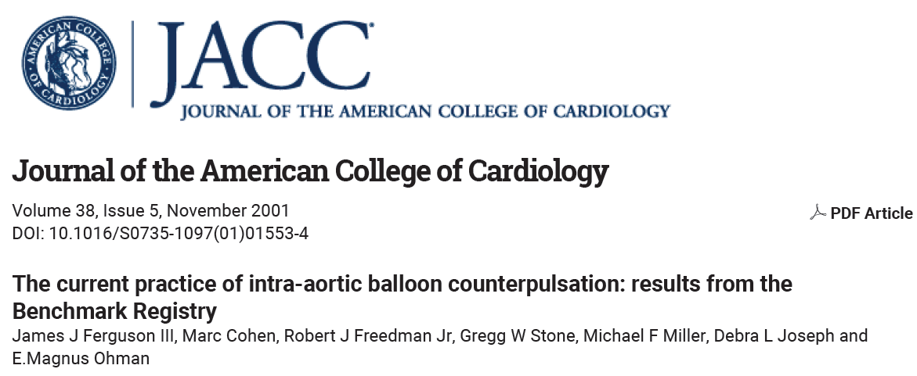
IABP : Complications

Slide 60
IABP : Complications

Slide 61
IABP : Complications
Major complications (2.8%)
Limb ischemia
Severe bleeding
Balloon leak
Death directly attributable to IABP cathteer
Minor complications (4.2%)
Limb ischemia resolved after catheter removal
Non-severe bleeding
IABP related overall mortality 0.5%
With development of small size catheter, complication rates are decreasing.
Notes:
Limb ischemia requiring surgical intervention
Severe bleeding requring BT

Slide 62
IABP : Complications
Patients with greatest risk of developing complications:
Females
Diabetics
Smokers
obese patients
PVD
HTN
shock

Slide 63
IABP : Complications
Aortic wall dissection, rupture or local vascular injury
Surgical correction may be required
Emboli: thrombus, plaque or air
100% oxygen
Intubatation
Trendelenberg in left lateral decubitus position
Hyperbaric chamber
fluid resuscitation and inotropic support etc.
Stroke
In setting of high risk STEMI IABP has 2% absolute increase in stroke rate. (Fuchs et al)
Notes:
Oxygen may reduce bubble size by increasing the gradient for nitrogen to move out.
intubate for significant respiratory distress or refractory hypoxemia.
Promptly place patient in Trendelenburg (head down) position and rotate toward the left lateral decubitus position. This maneuver helps trap air in the apex of the ventricle, prevents its ejection into the pulmonary arterial system, and maintains right ventricular output.
hyperbaric chamber. Potential benefits (1) compression of existing air bubbles, (2) establishment of a high diffusion gradient to speed dissolution of existing bubbles, and (3) improved oxygenation of ischemic tissues and lowered intracranial pressure.
Administer 100% oxygen and Maintain systemic arterial pressure with fluid resuscitation and vasopressors/beta-adrenergic agents if necessary.
Consider transfer to a Circulatory collapse should be addressed with CPR and consideration of more invasive procedures as described above.

Slide 64
IABP : Complications
IABP Rupture:
Can cause air embolism
COFFEE GROUNDS seen in the drive line is a precursor to a rupture
IF THERE IS A FLAGRANT RUPURE OF THE IABP CLAMP THE GAS LINE!
Infection
Check catheter insertion site often
STRICT ASEPTIC TECHNIQUE
Restrict movement while IABP in place

Slide 65
IABP : Complications
Hematologic
Daily blood test during IABP to rule out anemia and thrombocytopenia
ALL PATIENTS typed & crossmatched!
Blood transfusion as required
Malposition
Too high – obstruction of left subclavian and carotids
CHECK LEFT RADIAL ARTERY PULSE
Too low – obstruction of renal and mesenteric arteries
MONITOR URINE OUTPUT
Notes:
Anemia due to hemolysis.

Slide 66
IABP : Contraindications

Slide 67
IABP : INDICATIONS
Hemodynamic compromise
Cardiogenic shock
Inability to wean from bypass after cardiac surgery
Hemodynamic support while awaiting transplantation
Severe arrhythmia owing to refractory ischemia
Medically refractory ischemia
Medically refractory unstable angina
Failed PCI with refractory ischemia
Notes:
Cardiogenic shock due to acute MI, VSR, acute MR, myocarditis, sepsis, drugs etc.

Slide 68
IABP : INDICATIONS
Prophylactic high risk intervention
High risk PCI
Patient-specific
Lesion-specific
Clinical presentation
PCI during acute MI
Notes:
Patient-specific variables increased age, impaired left ventricular function, symptoms of heart failure, diabetes mellitus, chronic kidney disease, prior myocardial infarction, multivessel or left main disease.
Lesion-specific variables encompass anatomic characteristics such as left main stenosis, bifurcation disease, ostial stenoses, heavily calcified lesions, and chronic total occlusions
Clinical presentation including severe LVD and cardiogenic shock

Slide 69
Evidence for the use of IABP in MI and cardiogenic shock
GUSTO-I trial (1997)
A large-scale trial looking at the use of thrombolysis for AMI with or without IABP use
Early IABP use was associated with a lower 30-day mortality (47% vs 60%)
More bleeding complications being detected in the IABP group

Slide 70
Evidence for the use of IABP in MI and cardiogenic shock
NRMI-2 (2001)
A prospective observational cohort
IABP use together with thrombolysis resulted in a decrease in the 3-day odds of death by 18%.
Poor quality of the study

Slide 71
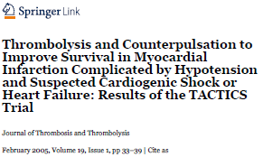
Evidence for the use of IABP in MI and cardiogenic shock
TACTICS trial (2005)
Small trial, 57 patients; thrombolysis alone vs thrombolysis plus IABP.
There was no additional survival benefit in the IABP group in 30 days follow-up..

Slide 72
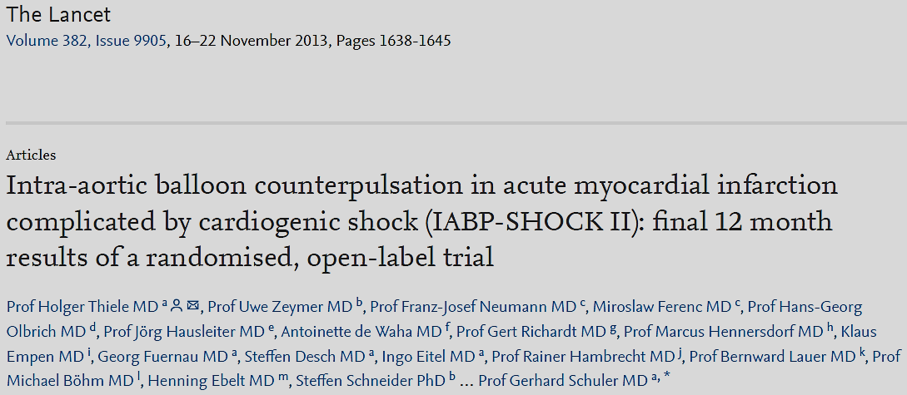
Evidence for the use of IABP in MI and cardiogenic shock
IABP-SHOCK II trial (2012)
The trial randomised post-MI patients with CS (n= 600) to either IABP or no IABP.
There was neither improvement in 30-day mortality, nor 1-year mortality, nor in any of the secondary outcomes (eg. stroke or functional capacity)

Slide 73
Post-MI and Cardiogenic Shock
AMI is complicated by CS in ≈5% to 10% of cases
In addition to revascularization, optimal drug therapy, vasopressor, and inotropic support, IABP is the most commonly used mechanical support device to maintain hemodynamic stability
In the thrombolytic era, concomitant IABP in the presence of recombinant- tissue plasminogen activator was thought to enhance thrombolysis through augmentation of perfusion pressure

Slide 75
Use of IABP as an adjunct to PCI in post- MI CS -- controversial.
A recent meta-analysis of registry data showed no benefit from the use of IABP in CS with regard to 30-day mortality independent of reperfusion strategy.
Recent downgrading of the American Heart Association guidelines on hemodynamic support in post-MI CS from a Class I recommendation to Class IIB

Slide 76
IABP in High risk PCI
The first randomized controlled trial to examine the use of elective IABP in high-risk PCI was the Balloon pump–assisted Coronary Intervention Study (BCIS-1)
There was no significant difference in the in-hospital major adverse cardiovascular or cerebrovascular event rates (primary outcome) of patients in the elective IABP (15.2%) compared with no-IABP groups
long-term all-cause mortality at a median follow-up of 51 months was significantly less in the elective IABP group compared with no IABP (P=0.039)
Notes:
Patient-specific variables increased age, impaired left ventricular function, symptoms of heart failure, diabetes mellitus, chronic kidney disease, prior myocardial infarction, multivessel or left main disease.
Lesion-specific variables encompass anatomic characteristics such as left main stenosis, bifurcation disease, ostial stenoses, heavily calcified lesions, and chronic total occlusions
Clinical presentation including severe LVD and cardiogenic shock

Slide 77
The evidence suggest that routine IABP use does not provide clinical benefit in patients undergoing high-risk procedures or those with AMI in the absence of CS.
The current American Heart Association guidance
It reasonable to consider elective IABP in high-risk PCI in a carefully selected subgroup (Class IIB) but not in patients with AMI in the absence of CS

Slide 78
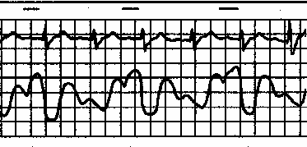
Question 1
Assess the timing in the following strip
Correct Timing
Early inflation and late deflation
Early inflation and early deflation
Correct inflation and early deflation
Late inflation and early deflation

Slide 79
Question 2
The indications for IABP therapy include A/E:
Cardiogenic shock following acute myocarditis
Acute mitral regurgitation with pulmonary edema from papillary muscle rupture
Acute VSD following myocardial infarction
Acute aortic regurgitation from edocarditis

Slide 80
Question 3
What is wrong in this wave?

Slide 81
Question 4
What is wrong in this wave?

Slide 82
Question 5
What size of cather will be used in a female patient of height 5 feet 5 inch?
25 cc
34 cc
40 cc
50 cc

Slide 83
Conclusions
IABPs are extremely useful in stabilizing pts with complicated cardiac disease
Risk factors for complications with IABPs are: female sex, PVD, small BSA, age
Troubleshooting with waveform analysis is critical, and is just as important as knowing how to insert an IABP
Prophylactic insertion of an IABP for hemodynamic support in high risk PCI pts may be superior to a “rescue” strategy
Controversy has arisen as to the utility of IABP and more studies needed, especially re: impact of timing of placement

Slide 84
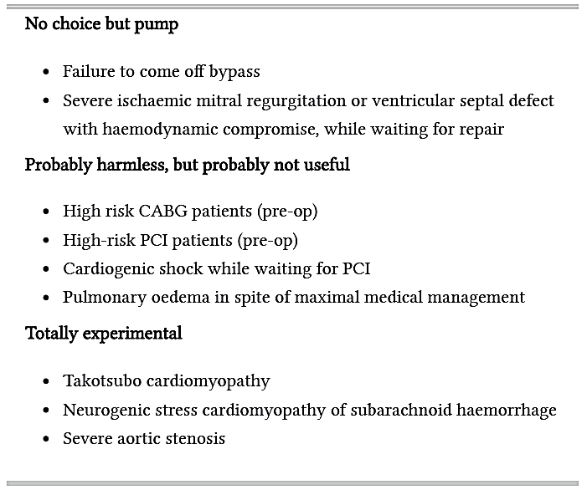
Conclusions

Slide 85
THANK YOU

